Slide 1
LCD PROJECT
GROUP 4

Slide 2
TOPIC
A WAY TO PLAY ROCK PAPER SCISSORS FOR 2 PLAYER WITH SCORE BOARD

Slide 3
Introduction
This project implements a two-player Rock–Paper–Scissors game entirely using digital logic circuits without the use of microprocessors, demonstrating practical applications of combinational and sequential logic concepts from the syllabus.

Slide 4
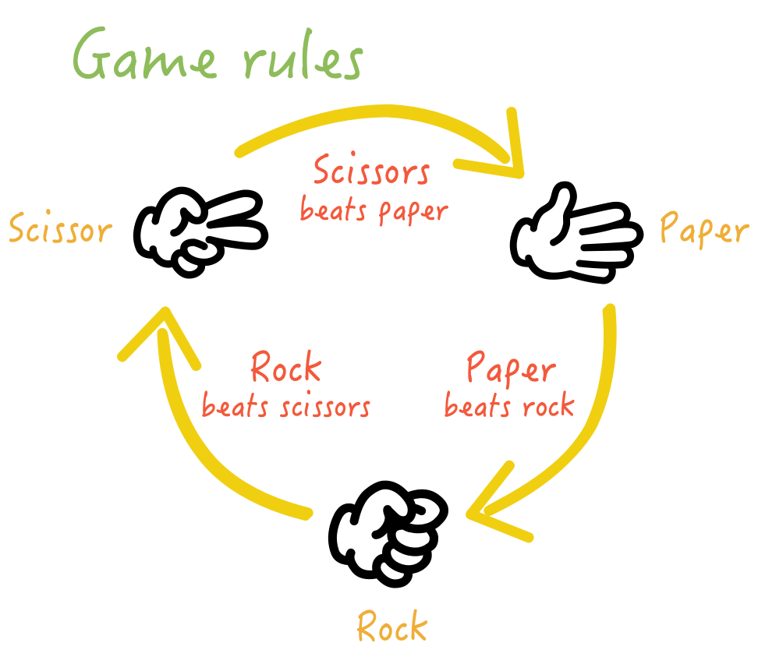
What is rock paper scissors?
Rock paper scissors is a simple hand game played by two people where each player simultaneously forms one of three shapes with their hand: rock (a closed fist), paper (a flat hand), or scissors (two extended fingers). The rules are: rock crushes scissors, scissors cuts paper, and paper covers rock. The game is often used to make decisions, as the winner of each round is clear.

Slide 5




OBJECTIVES
1. To design and implement a two-player Rock–Paper–Scissors game entirely using digital logic circuits, without any microprocessor or microcontroller.
1. To design and implement a two-player Rock–Paper–Scissors game entirely using digital logic circuits, without any microprocessor or microcontroller.
2. To apply combinational and sequential logic concepts learned in the syllabus for a real-time interactive system.
2. To apply combinational and sequential logic concepts learned in the syllabus for a real-time interactive system.
3. To develop a combinational logic circuit using AND, OR, and NOT gates for determining the round outcome.
3. To develop a combinational logic circuit using AND, OR, and NOT gates for determining the round outcome.
4. To incorporate sequential control logic for managing game flow, round limitation, and system reset functions
4. To incorporate sequential control logic for managing game flow, round limitation, and system reset functions

Slide 6
WORKING
1. Player Input:
Each player selects their choice—Rock, Paper, or Scissors—using individual switches or buttons.
2.Combinational Logic for Decision Making:
The inputs from both players are fed into a combinational logic circuit constructed with AND, OR, and NOT gates.
The logic circuit compares the choices of the two players and determines the outcome of the round:
Win: Player 1 beats Player 2 (or vice versa)
Tie: Both players choose the same option

Slide 7
3. Sequential Logic for Scorekeeping and Display: functions of CD4026
1 Counting (Sequential Logic Function)
Each CD4026 contains a decade counter (counts 0–9) built from internal flip-flops.
In this project, this counting action is used to:
Keep track of rounds (for example, up to 3 or 6, depending on the mode switch), or
Display each player’s score as the game progresses.
Every time a player wins a round, a clock pulse is sent to that player’s CD4026 input pin (CLK), incrementing the count by 1.
2 Decoding and Display Driving
The CD4026 also includes a BCD (binary-coded decimal) to 7-segment decoder/driver.
This means it automatically converts the binary counter value into the correct signals (a–g) to light up the 7-segment display.

Slide 8
4. Signal Processing and Decision ICs:
CD4073 (AND gates) and CD4069 (NOT gates) are employed to process signals from the switches and generate the correct outcome signals.
These ICs handle all intermediate logic operations to ensure accurate and immediate response.
Outputs from logic circuit are fed to counter to read the score of each player.
The mode selecter decides, with the help of user input, after how many rounds the game should be reset.
5. Gameplay Flow:
The sequential circuit updates the score and displays it on the respective 7-segment displays.
Once both players have made their selections, the combinational logic instantly determines the result.
The system continues until a predefined number of rounds(3 or 6) are completed.

Slide 9
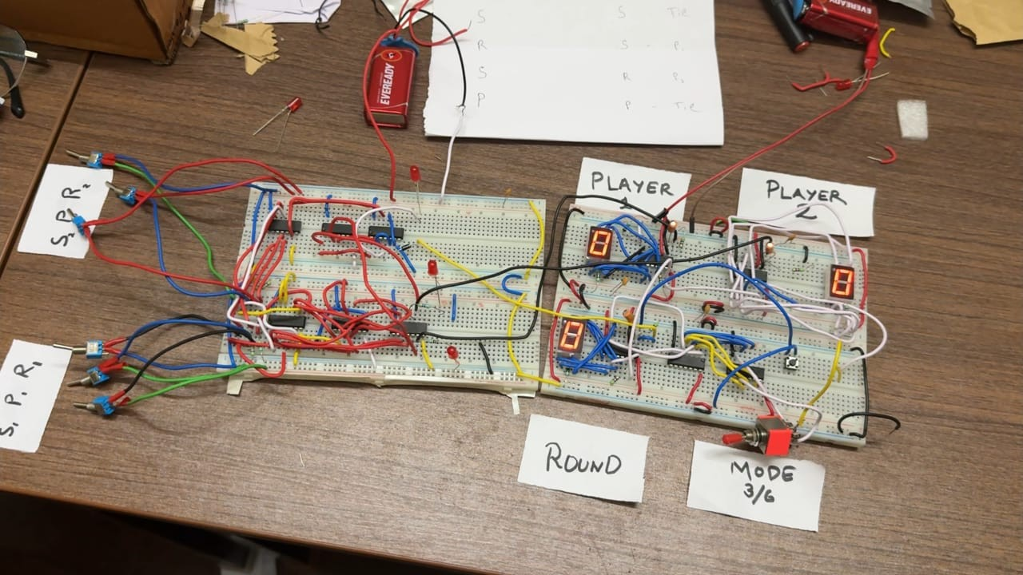

Slide 10
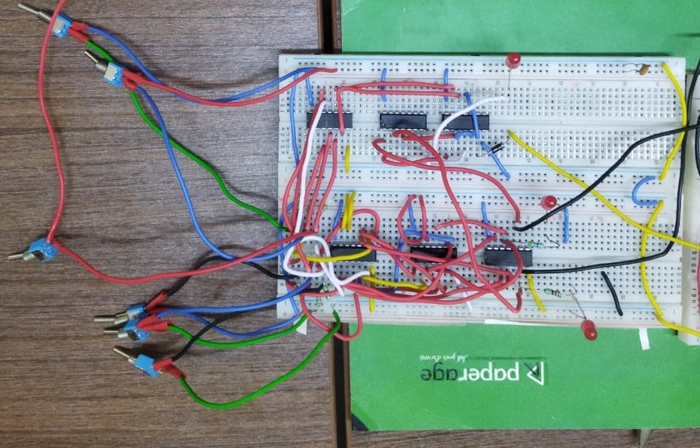
Game logic circuit

Slide 11
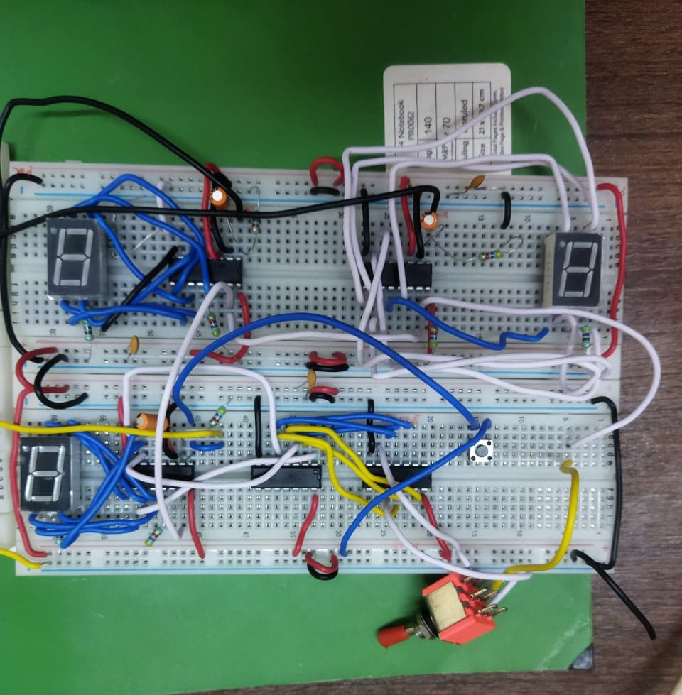
Counter and mode selecter circuit

Slide 12
Components used
1. CD4026 – Decade Counter/Divider IC
2. CD4073 – Quad 2-Input AND Gate IC
3. CD4073 – Triple 3-Input AND Gate IC
4. HCF4075 – Triple 3-Input OR Gate IC
5. CD4069 – Hex Inverter IC
6. Momentary Push Buttons (Tactile Switches)
7. Toggle Switch (2-Pin ON–OFF, 3-Pin ON-ON)
8. 7-Segment LED Display (Common Cathode)
9. 470 Ω Resistor (Current limiter)
10. 47 kΩ Resistor (Pull down resister)
11. 100 nF Ceramic Capacitor (decoupling (or bypass) capacitor)
12. 1 µF Electrolytic Capacitor (To debounce)
13. Breadboard
14. Wires

Slide 13
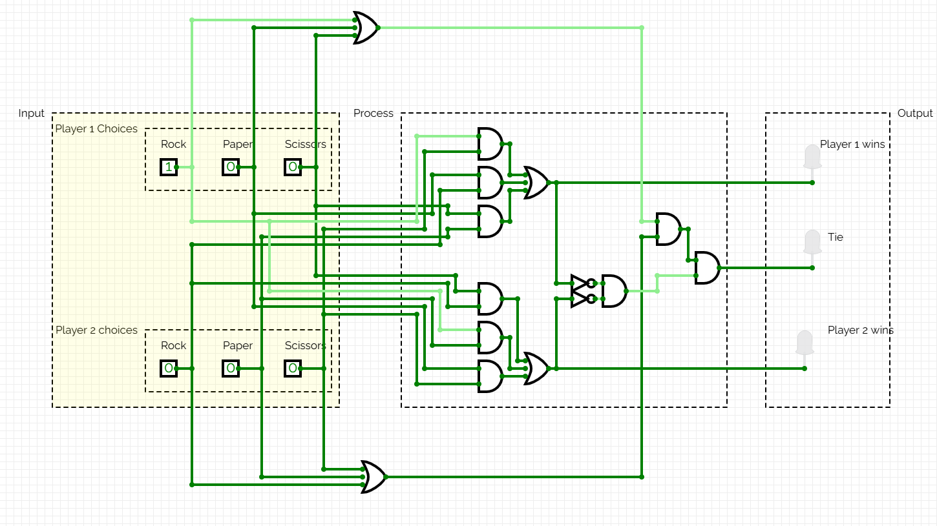
SCHEMATIC
Schematic diagram of game logic

Slide 14
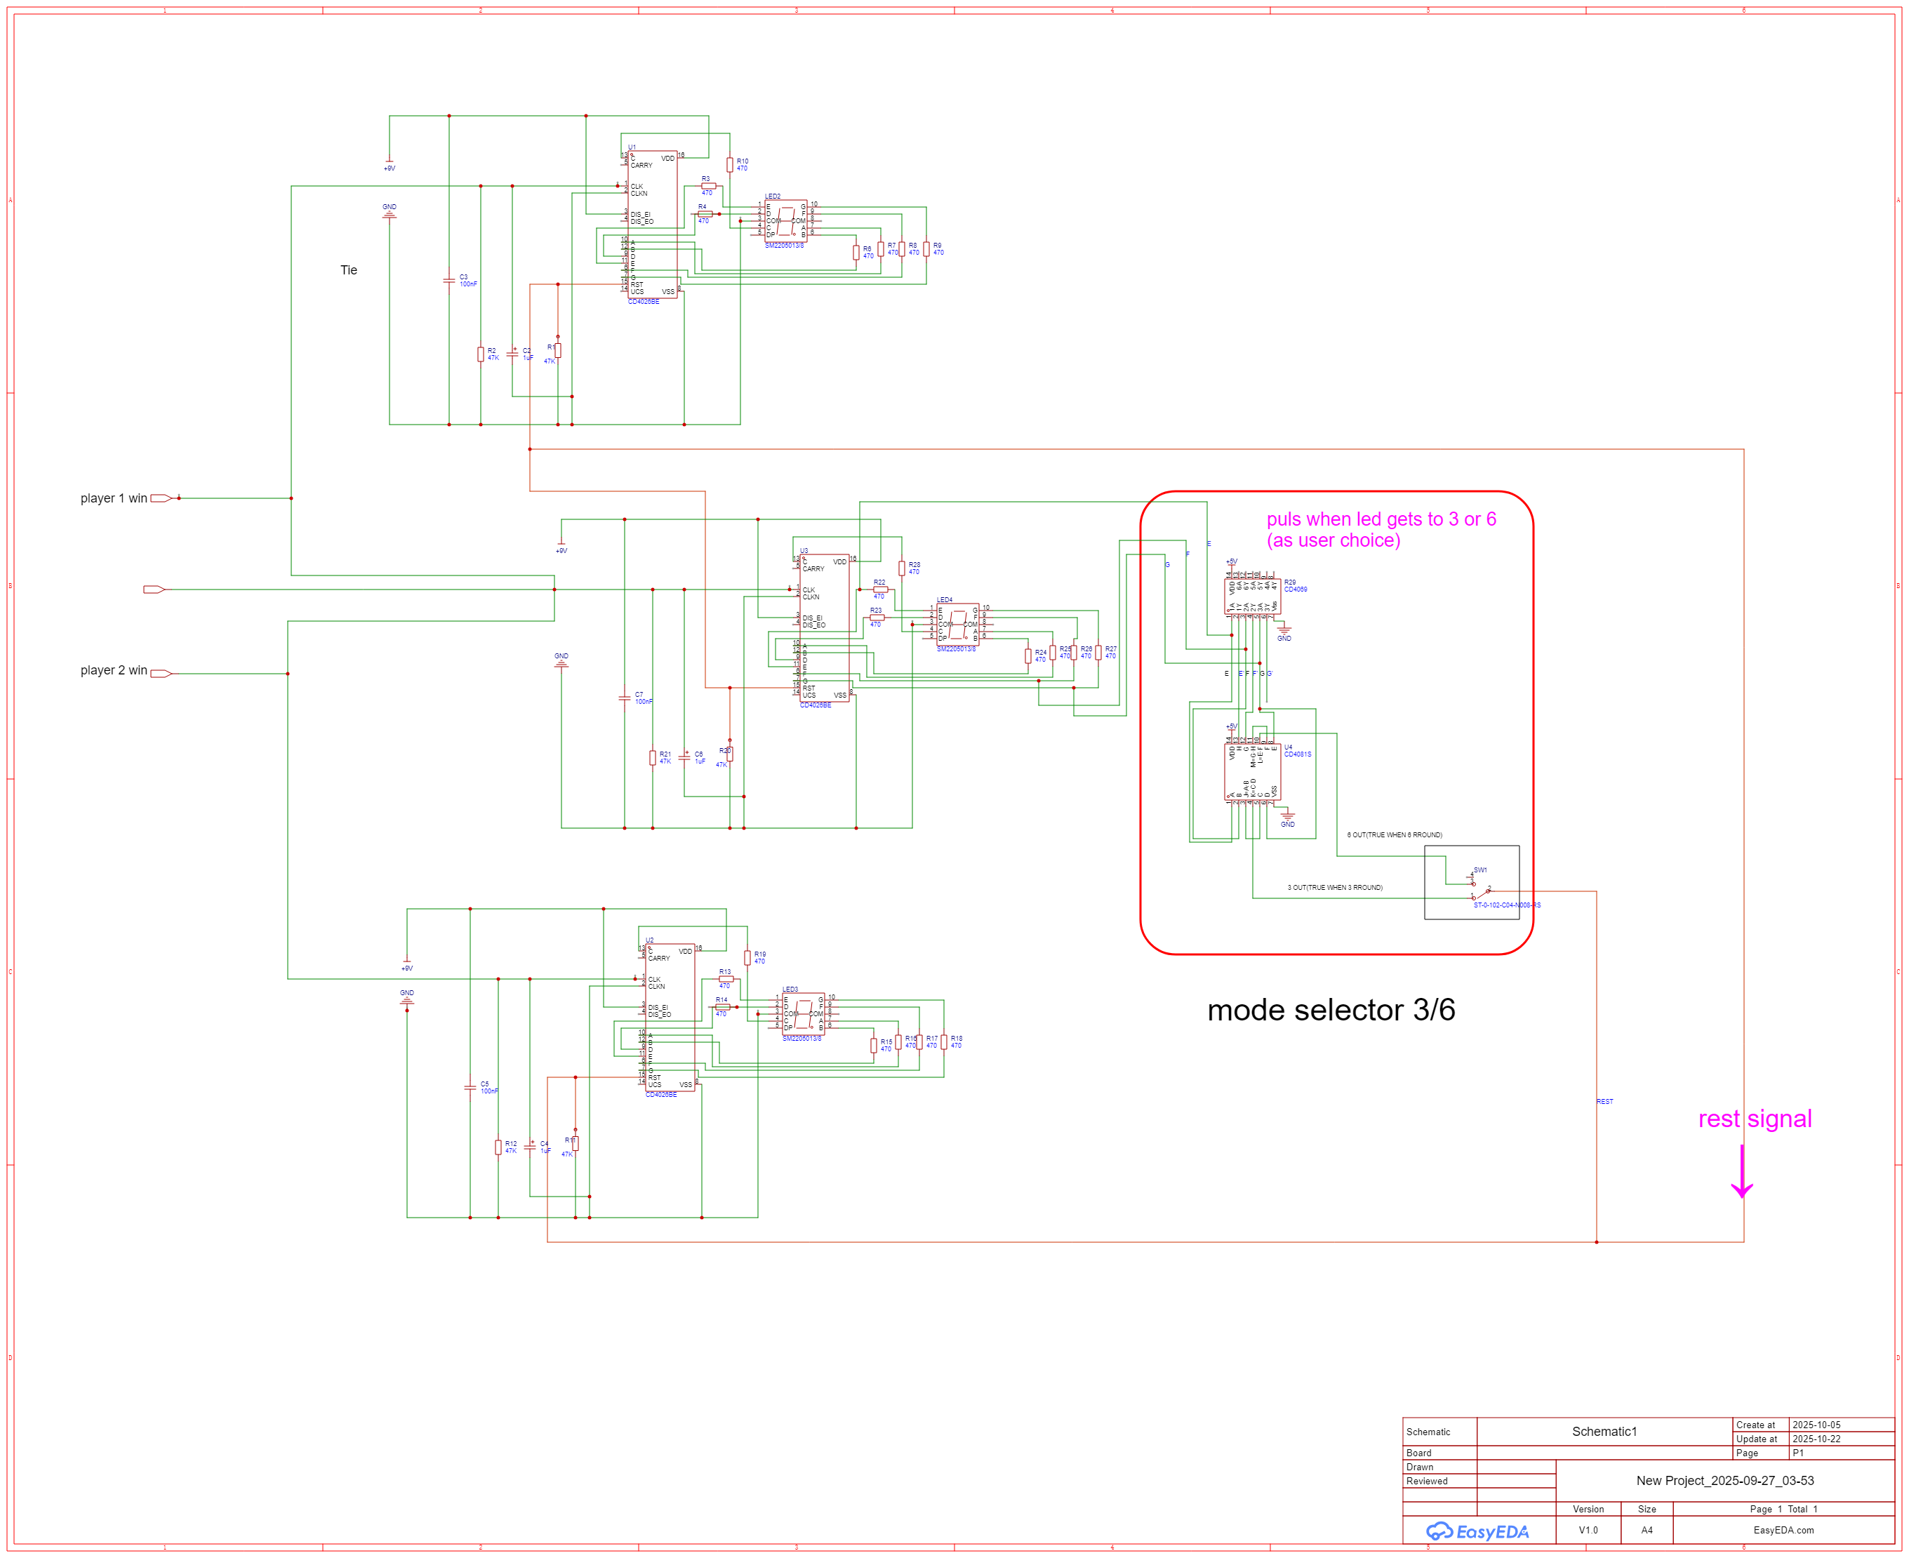
Player 1
Total round
Player 2
Schematic diagram of counter and mode selector

Slide 15
CONCLUSION
This project highlights how fundamental digital logic principles can be integrated to develop a fully functional, real-time interactive system. It reinforces theoretical knowledge through hands-on circuit design, deepens understanding of combinational and sequential system implementation, and illustrates the capability of logic ICs in building processor-free digital applications.

Slide 16
THANK YOU

